Slide 1

Objective :
Smart Health Care Waste Segregation and Safe Disposal
The main objective of this invention is to propose a smart device for biomedical waste segregation, the waste being produced especially in hospitals and in health care centers which produce hazardous waste and safe disposal of the same based on IoT. To reduce the impact of the covid-19 pandemic on the current waste management system and to promote cities that give a decent quality of life to its citizen a clean and sustainable environment using sensor systems technology is proposed.

Slide 2
Impact of proposed Solution :
The impact of the proposed solution is as follows:
Segregation of the waste is made so easy.
It reduces the amount of wastebins required in a place.
No overflowing bins and less unpleasant odors.
Reduce in manpower, emissions, fuel use and traffic congestion.
Reduces infrastructure, operating and maintenance costs by up-to 30%.
Emphasizes on healthy environment and keep premises more beautiful.

Slide 3
Working of the project :
If medical waste is disposed of in the inlet, it is transferred to the chain conveyor belt, which triggers the DC motor which causes the conveyor belt to move. Metal, dry, wet, glass, and incinerate wastes are dissevered into five categories. The sensors detect the waste predicated on the type of waste, and the waste is then sorted into concrete bins. The state of filling the bin is immediately signaled by LEDs utilizing artificial perspicacity. The red LED on the bin commences flashing as it approaches full capacity, and a caveat note is sent to the local ascendant entities. The waste that has been filed is immediately bundled. The wastes that must be incinerated are burned in the contrivance's incinerator chamber. The thermo-engenderer converts the heat engendered in the incinerator chamber into electrical energy. The conveyor belt's DC motor consumes the engendered electrical energy. The conveyor belt is automatically washed until the whole operation is consummated utilizing a chain conveyor belt cleaning machine. After the waste gets wrapped the municipal commission gets an alert message through the app.

Slide 4
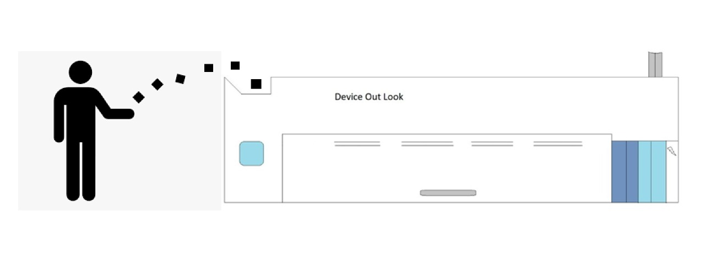
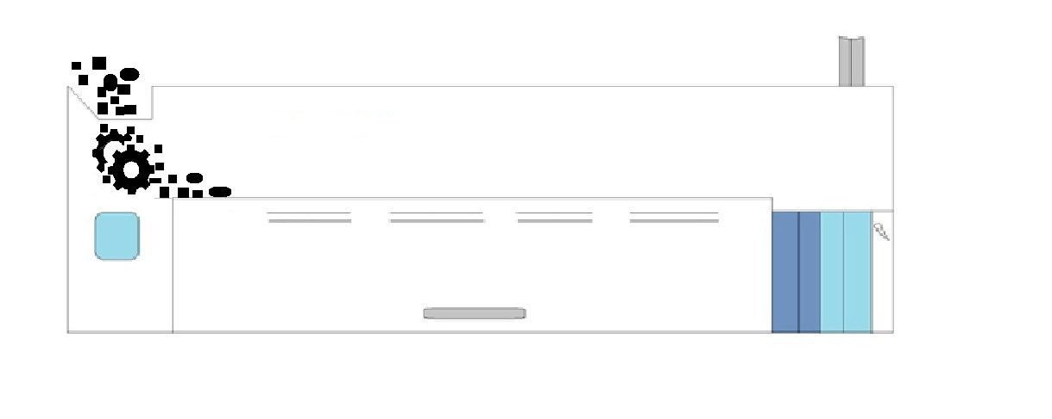
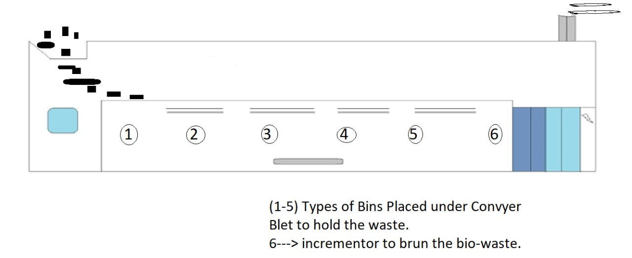
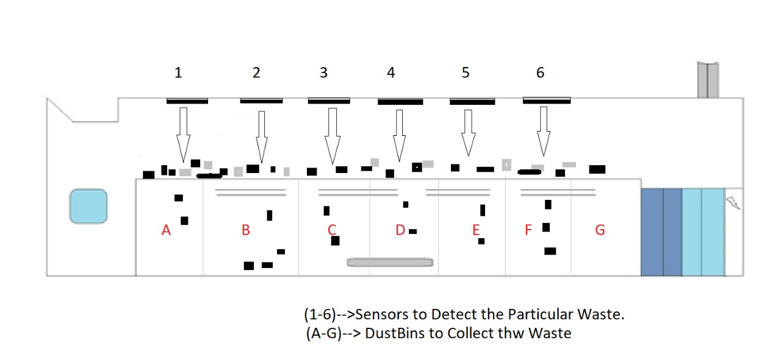
Process Flow:
SPLIT ROLLERS
CHAINED CONVEYER BELT

Slide 5
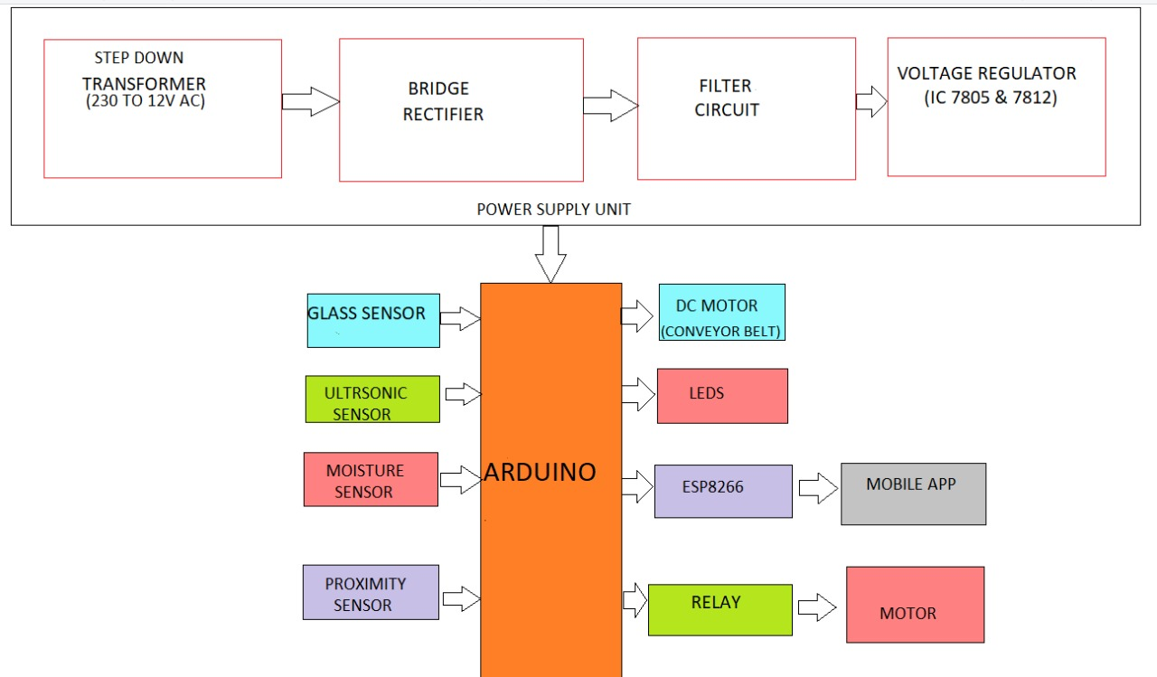
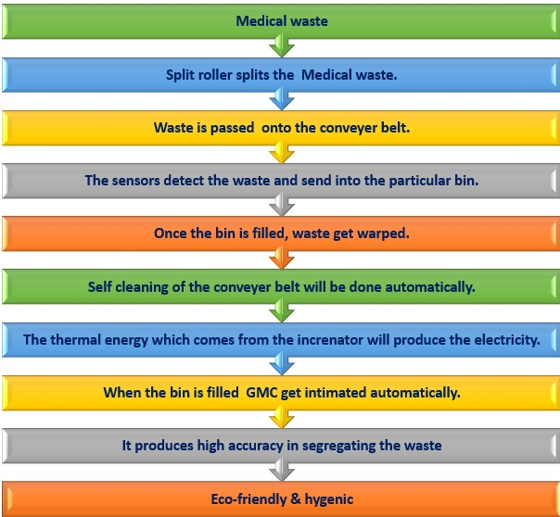
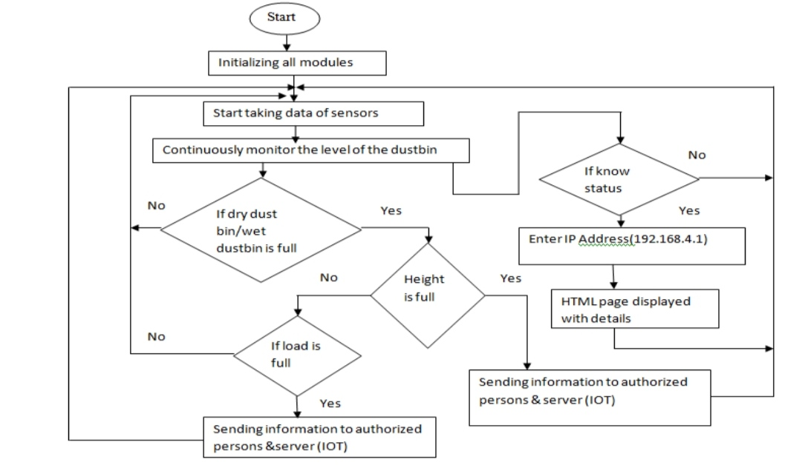
WORK FLOW AND SENSOR ALIGNMENT :
Conclusion:
The automated waste segregator is an efficient and economic waste collection system with a minimum amount of human intervention and also causes no hazard to human life. Employing a conveyor belt makes the system much more accurate, cost-effective, and also easier to put in and use at a domestic level. The proposed system meets the demand for constant checks on garbage content in the bins. It helps to dispose of the waste material before it overflows from the bins. So regular monitoring and intimating make the system useful in waste management. This leads to a clean city for better living.

